Slide 1
7 Seater Sofa Set
GKW Retail

Slide 2
7 Seater Sofa Set
GKW Retail has a large selection of beautiful 7 Seater Sofa Set for any living room that always enhance your modern look

Slide 3
7 Seater Sofa Set
We offer high-quality materials at reasonable prices. They are available in a number of designs, shapes, and sizes, so you will have plenty of options to decide from regardless of your home's decor.

Slide 4
7 Seater Sofa Set
•The 7 Seater Leather Sofa balances style and comfort.
•This trendy sofa will emphasize your own environment, whether it is a formal Bed room or a family area.

Slide 5
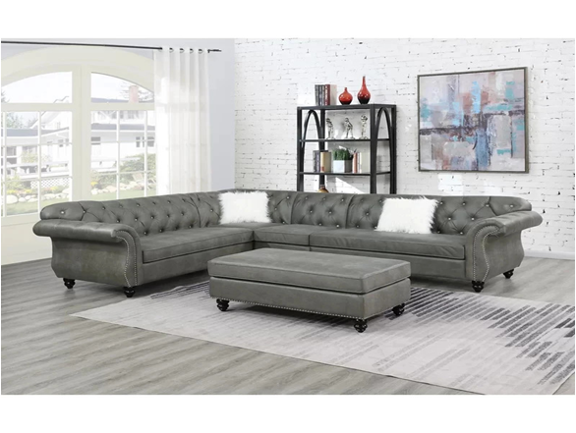
Wide Faux leather Sofa 7 Seater Set

Slide 6
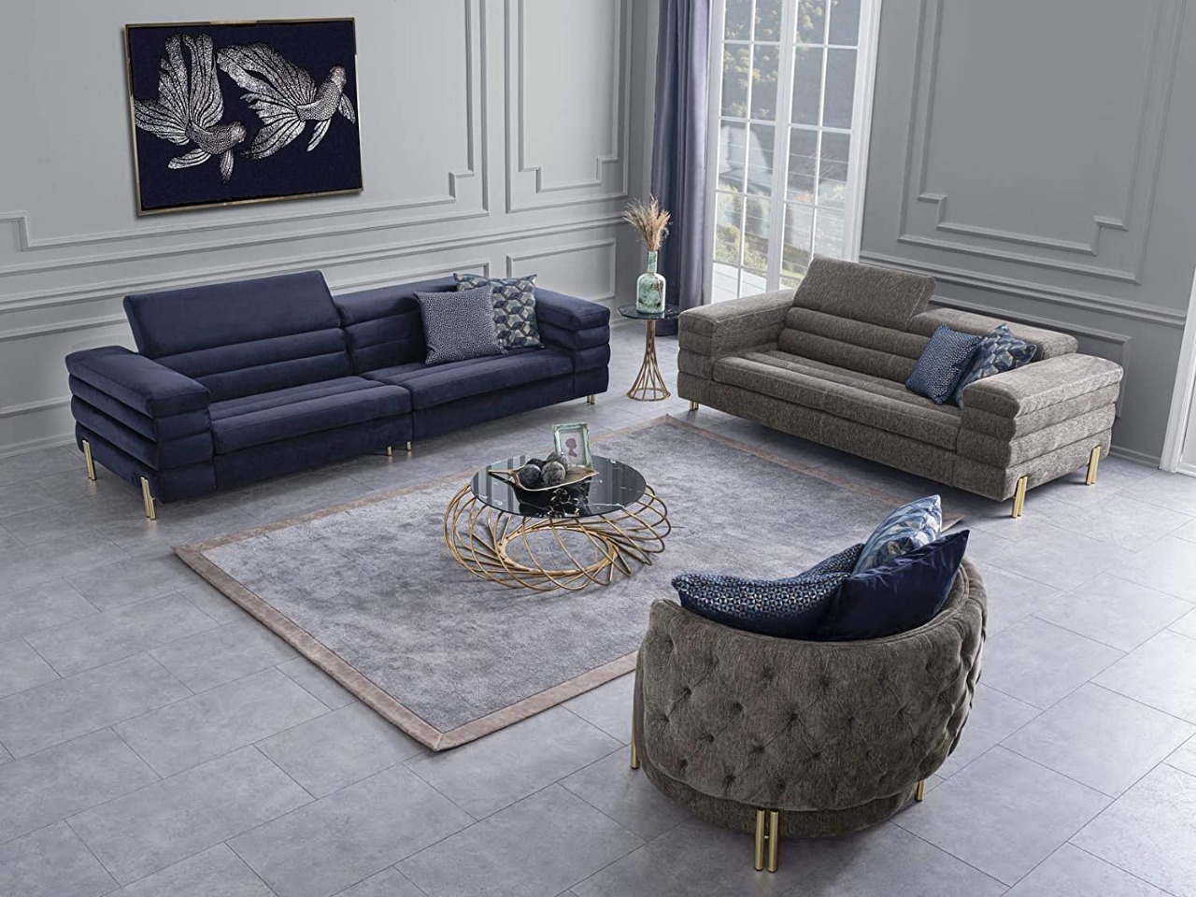
4+2+1 Fabric 7 Seater Luxury Furniture Sofa Set

Slide 7
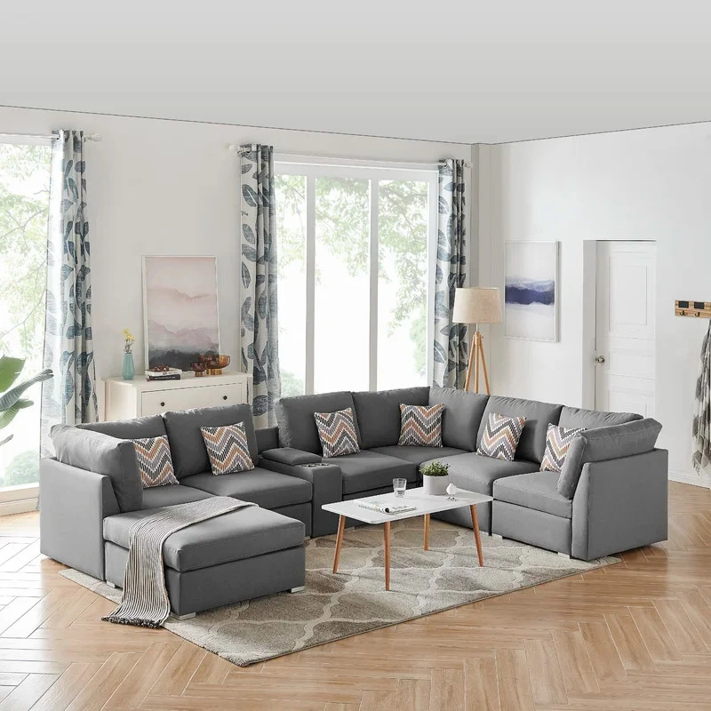
131 Wide Modular Corner Sectional U Shape Sofa Set

Slide 8
Thank You

